Slide 1
Design and Development of Deep Learning-Aided Vision Guidance System for AUV Homing Applications
Bill Turbadrakh
Notes:
Welcome everyone. Today, I’ll be presenting a 2024 IEEE article on the design and development of a deep learning-aided vision guidance system for Autonomous Underwater Vehicles, or AUVs. The goal was to improve short-range underwater docking accuracy using real-time object detection.

Slide 2
Why This Matters
AUVs are essential for underwater exploration and monitoring
Limited by battery capacity → need reliable docking
Turbid water & poor visibility challenge existing guidance systems
Notes:
AUVs are vital for deep-sea mapping, inspections, and surveillance. However, their limited battery capacity restricts mission time. Docking stations help recharge them mid-mission. But docking in murky water is tough — this paper tackles that problem using vision and AI.

Slide 3
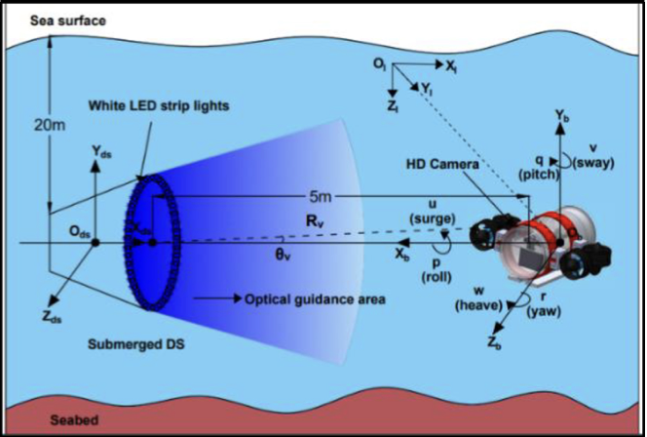
Research Objectives
Develop a deep learning-guided system for very short-range homing (~5 m)
Use YOLOv5 for real-time detection of illuminated docking station (DS)
Ensure accurate pose estimation in the XY plane
Notes:
The research goal is to guide AUVs to dock precisely using onboard vision systems. Instead of relying on acoustic signals, this method uses image recognition powered by YOLOv5, a real-time object detection model.

Slide 4

System Components
Illuminated circular Docking Station (white LED strip)
AUV prototype: 4 propellers, HD front camera, Nvidia edge GPU
Control system: PID controller for motion
Notes:
The setup includes a lit docking station visible even in low-light water, a smart AUV with embedded processing power, and standard PID control logic to move toward the target.

Slide 5
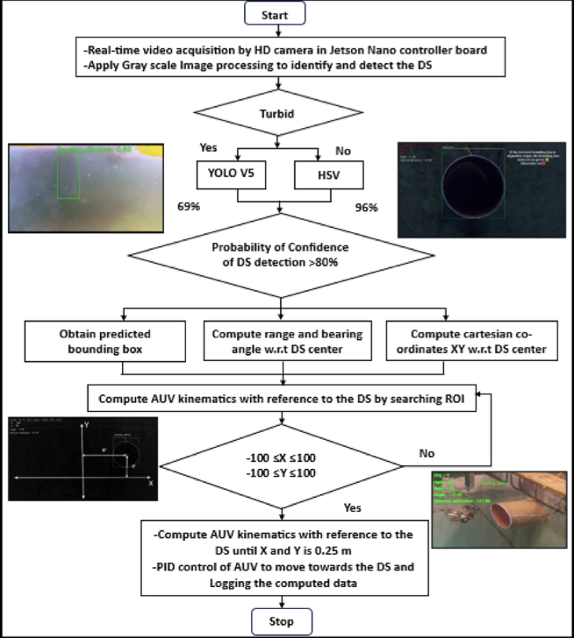
Vision Architecture
YOLOv5 + HSV color filtering used for detection
Region of Interest (ROI) tracking to reduce false positives
DeepSORT used for object tracking over time
Notes:
The deep learning model identifies the docking station and tracks it. YOLOv5 helps locate the object, HSV filters enhance the color contrast, and DeepSORT handles continuity in tracking even if visibility drops briefly.

Slide 6
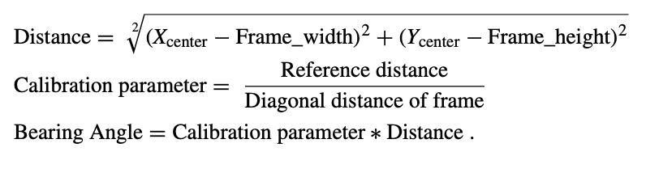
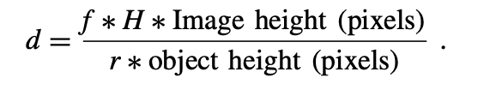
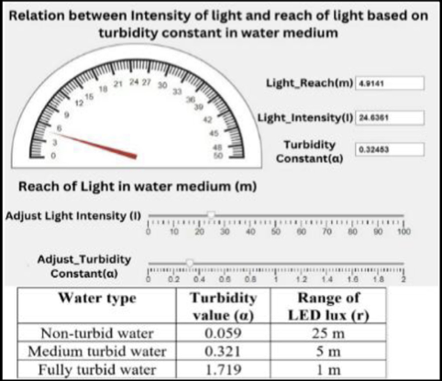
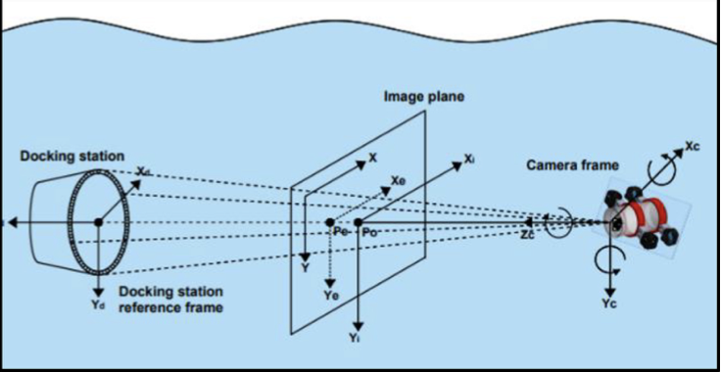
Pose Estimation
Range calculation: uses image size and camera focal length
Bearing angle: computed from bounding box center
XY pose relative to DS computed with ROI offsets
Notes:
Once the station is detected, the AUV calculates how far it is and in what direction it needs to move. It adjusts its position in the XY plane accordingly to line up with the docking entry.

Slide 7
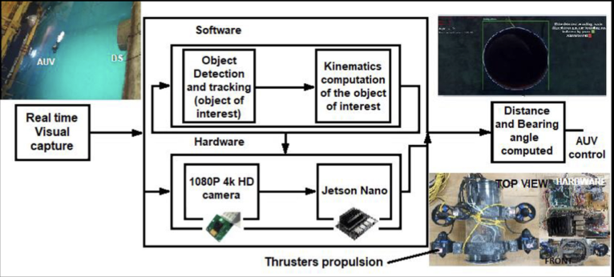
Hardware Architecture
Nvidia Maxwell GPU with 128 cores
4 GB RAM, ARM Cortex-A57
25 fps HD video streaming from 5 MP front camera
Limitations: YOLOv7/8 too heavy for current onboard hardware
Notes:
The edge computer is powerful but still constrained. YOLOv5 was chosen over newer versions because of the balance between speed and performance, considering the AUV’s hardware limits.

Slide 8
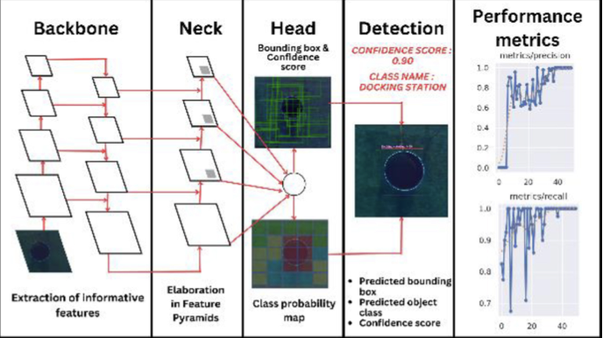
Dataset and Model Training
132 images total (clear and turbid water)
  79 train, 40 validation, 13 test
Mean Average Precision (mAP): 0.95
Notes:
The model was trained on a modest dataset with a good balance of water conditions. The high mAP score of 0.95 shows it reliably detects the docking station even in slightly murky conditions.

Slide 9
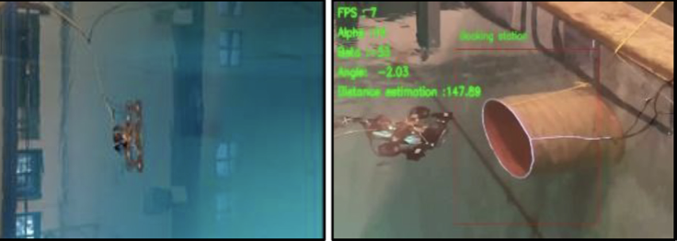
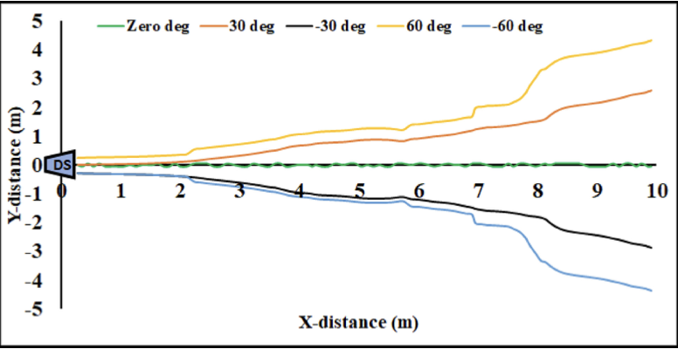
Performance Results
Less - Turbid Water:
95% detection rate
5 m detection range
5% position error
High-turbid water:
60–70% detection rate
1 m range
Up to 25% error
Notes:
In good visibility, the system performs excellently. Even in murky water, it still detects the station most of the time, though at reduced range and accuracy.

Slide 10
Conclusive and Future Work
Reliable vision-based docking possible with YOLOv5
Embedded implementation is real-time and accurate
Future: lighter, faster models (e.g., YOLOv8 Tiny)
Notes:
This study shows vision-based short-range homing is viable with the right AI models and hardware. Future improvements could focus on reducing latency and improving detection under poor visibility conditions.

Slide 11
Discussion Questions
How could we improve the system’s reliability in high-turbidity water where vision guidance struggles?
If this system works well in 2D (XY plane), how might we adapt it for full 3D pose estimation in more complex underwater environments?
Notes:
One possible direction might be combining this vision system with another sensor type, like sonar or electromagnetic sensors, for a hybrid approach. That way, even if visibility drops, the AUV still has a backup method for localization.
I was thinking stereo vision or adding a depth camera might help. But that could also increase processing load, so we’d need to balance between hardware capability and tracking accuracy.

